Slide 1
“In the Hall of the Mountain King”
The Legend of Peer Gynt

Slide 2
The Composer!
Remember: A Composer is a person who writes music.
Grieg composed incidental music for the ‘Peer Gynt Suite’. Incidental music is music used in a film or a play as a background to create or enhance a particular atmosphere.
Grieg was born in Norway in 1843 and died in 1907.

Slide 3
The Legend of Peer Gynt
Grieg's 'Peer Gynt Suite' tells the story of a young boy – Peer Gynt, who falls in love with a girl but is not allowed to marry her. He runs away into the mountains but is captured by trolls who take him to their King. Peer Gynt tries to escape but is chased by the trolls and runs into the troll King but eventually gets away.

Slide 4
Watch the following video to hear the story of “The Legend of Peer Gynt”

Slide 5
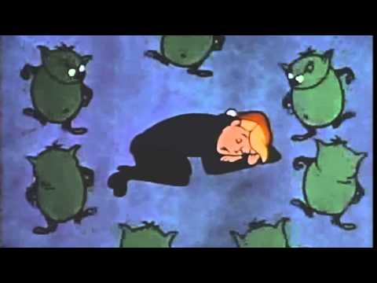

Slide 6
Listen out for: The strings that play the sounds of Peer tiptoeing and running to escape. The tiptoeing sound is an effect called pizzicato where string players pluck the strings of their instrument rather than use a bow.
In the next video get comfortable in a chair or sitting on the floor and see if you can keep up!

Slide 8
In the final video, pick a symbol:
After the 1 2 3 4 count in, follow your conductor and clap on your symbol.
For extra fun, assign a symbol to different family members.
Have fun!

Slide 10
Don’t forget to fill out your Google Form!

